Slide 1
React Tutorial
A guide by Priyanka Bonam, Akhila Gandra, Satyavrath Injamuri, Abhiram Madugula, and Amy White

Slide 2

What is React?
React is a JavaScript library/framework for creating user interfaces.
React is the View in MVC architecture.
Created and maintained by Facebook developers
Amy White

Slide 3
Why use React?
Declarative (State based)
React reuses functions/components
React (JSX) can combine code into one file
Virtual DOM
Very powerful and faster!
Amy White
Notes:
Declarative - developers declare component states, React components are predictable, components are rendered based on their state
React reuses functions/components - this allows for better organized code
React (JSX) - JSX adds XML syntax to JavaScript and is most often used with React
Virtual DOM - dynamically updated DOM without need of refresh entire page; one component can refresh without affecting other components or the UI as a whole

Slide 4
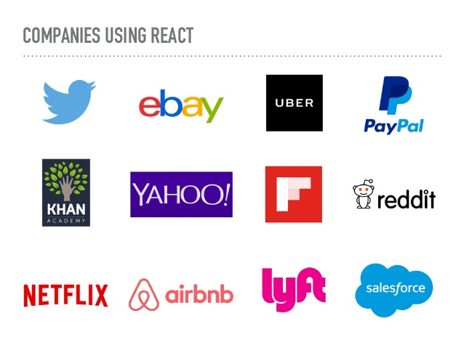
Amy White

Slide 5
Components
Components let you split UI(User Interface) into independent blocks self-contained reusable building blocks of web application .
Components define how features should look and behave on the UI.
Components can be rendered individually vs re-rendering the entire web page.
Data gets passed to and between components via props.
Akhila Gandra

Slide 6
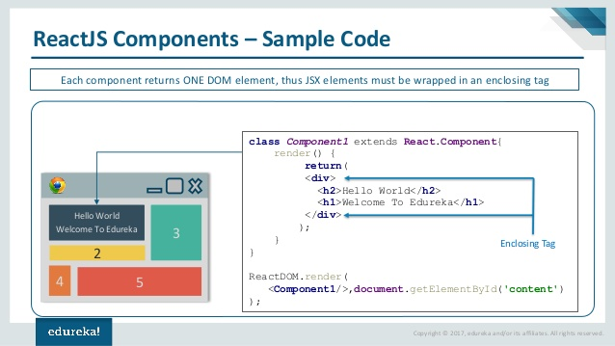
Akhila Gandra

Slide 7
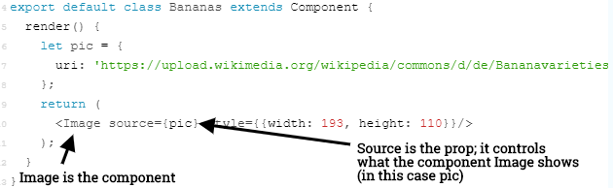
Props
Props are properties
Props allow for component customization
Akhila Gandra

Slide 8
JSX - JavaScript Syntax Extension:
A preprocessor step that adds XML syntax to JavaScript.
Looks like XML/HTML
const element = <h1>Hello, world!</h1>;
Can also create application without JSX
Akhila Gandra

Slide 9
Using JSX: function Welcome(props) { return <h1>Hello, {props.name}</h1>; }
Using ES6:
class Welcome extends React.Component { render() { return <h1>Hello, {this.props.name}</h1>; } }
Akhila Gandra

Slide 10
Virtual DOM
The big game changer.
React aims to re-render the virtual tree only when the state changes.
Uses 2 virtual trees (new and previous) to find differences and update real DOM.
Satyavrath Injamuri

Slide 11
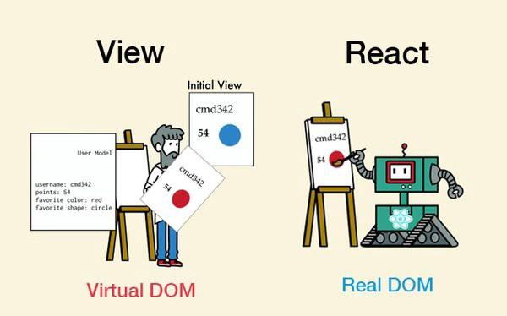
Satyavrath Injamuri

Slide 12

Amber vs Angular vs React
Satyavrath Injamuri

Slide 13
Let’s create a simple App using React JS
Open PowerShell Window
npm install -g create-react-app
The Create react app tool is used to create a Boilerplate project to build our application
npm create-react-app folder name
It creates a new project and import all dependencies to this project
cd create-react-app folder
npm run start
Runs the project in your local machine
Open via browser
Priyanka Bonam

Slide 14
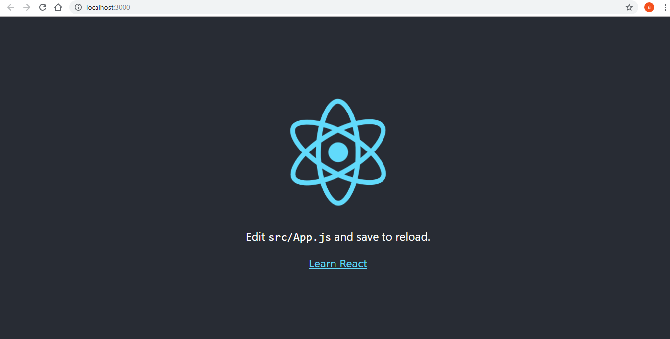
Type npm run start
This will start a development server and load up a browser pointing to our application
Priyanka Bonam

Slide 15
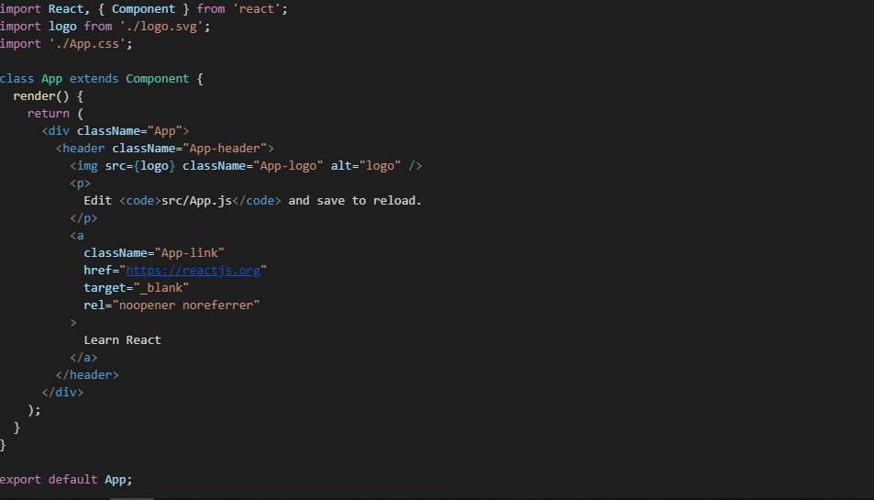
App.js
Priyanka Bonam

Slide 16
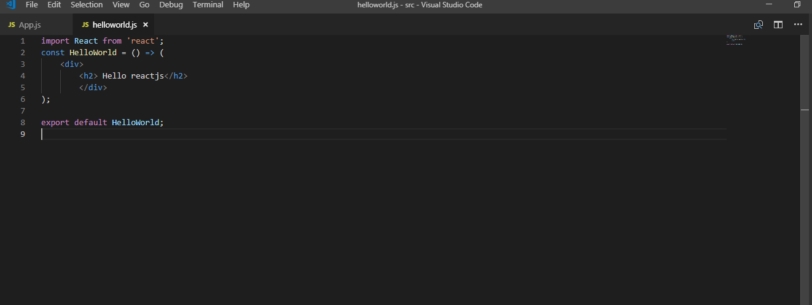
Create a component
Functional component
Priyanka Bonam

Slide 17
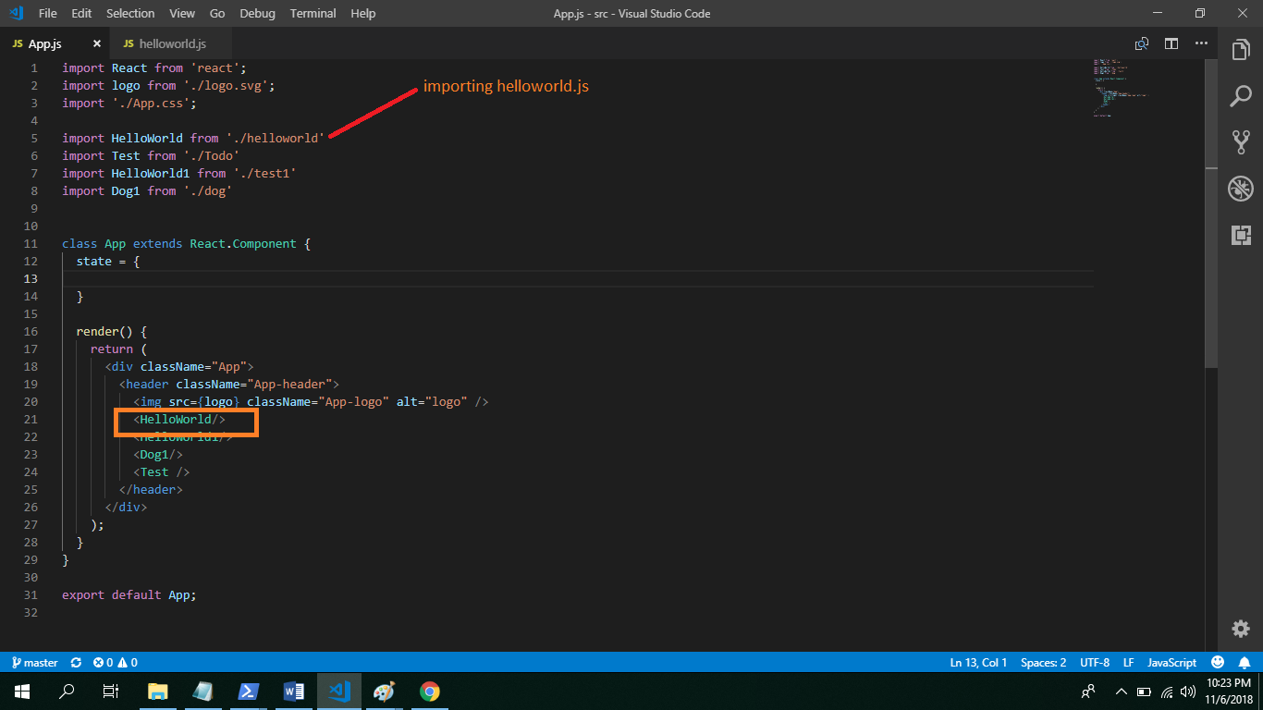
Adding to app.js
Priyanka Bonam

Slide 18
Class Component and State
Abhiram Madugula

Slide 19
Resources
https://facebook.github.io/react-native/docs/props
http://slides.com/alexanderfarennikov/react-js-fundamentals/fullscreen#/9/1
https://www.youtube.com/watch?v=6CeryXSUXPY
https://jakearchibald.com/2017/netflix-and-react/
https://www.taniarascia.com/getting-started-with-react/

